Slide 1
DevOps Final Project
Chatter
Ravi Kumar Pilla
Dinakara Sai Santosh Burugupalli
Priyam Mukund Modi

Slide 2
Introduction
· Token based authentication for user Sign in and Sign up
· Web application where user can tweet and see the recent tweet from all other users.
· User can comment and like the tweet and view tweets posted by others.
· Ability to stop user use offensive language
for tweets.
· Ability to deploy front-end as a PWA so that it can run on devices

Slide 3
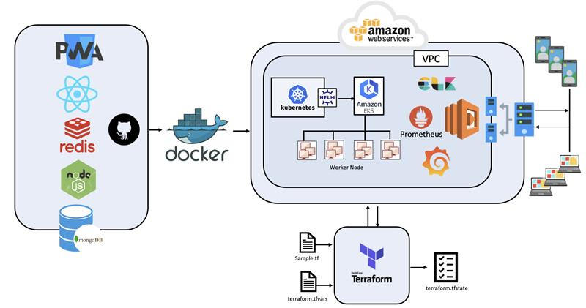
Project Architecture
Frontend - React, PWS
Middleware - Redis
Backend - Nodejs, MongoDB
Docker
Kubernetes
Helm Chart
Prometheus and Grafana
ELK
Terraform
AWS Cloud EKS

Slide 4
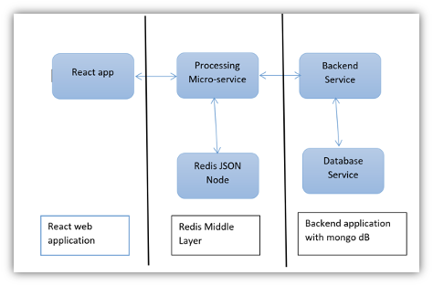
Application Architecture
React Application Process to the Middleware i.e Redis JSON
All the request are clustered in the Middleware
After every interval it is transferred to the Backend Server
The Redis JSON is connected to the backend Node JS server
Node JS Relates to MongoDB
User information is stored to the MongoDB for future interactions

Slide 5

Front End
The frontend application is created in React, which enables the application to run as a SPA.
Login and Sign Up screens
Home Screen for Feed
Comment and Like functionality
Token Based Authentication
Session based user management using cookies

Slide 6
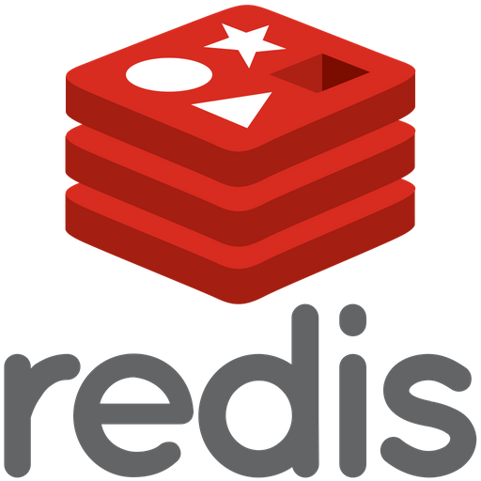
Middleware
The Redis server will act as the middleware for the application
All the request from the frontend will be forwarded to the Redis server
The cache is cleared for every 5 tweets and a bulk post method is triggered to backend
All the calls will be forwarded to the Node Server if the searched record is not present in the cache.

Slide 7

Back End
All the requests from the Redis JSON is forwarded to the Node JS Servers
The Server Controllers API exposes endpoints for tweet management and user management i.e., for creating bulk tweets and displaying tweets, adding comments, adding likes, removing likes to the tweet, registering and authenticating the user
The Nodejs backend server will never be accessed from frontend.
The server is only exposed to our redis server.

Slide 8
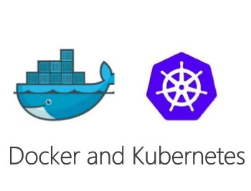
Infrastructure
Docker
All the layers are separately containerized in the Docker Container
The Docker containers are further deployed as the Kubernetes pods
Kubernetes
Infrastructure provisioning using Terraform
AWS - EKS service is used

Slide 9
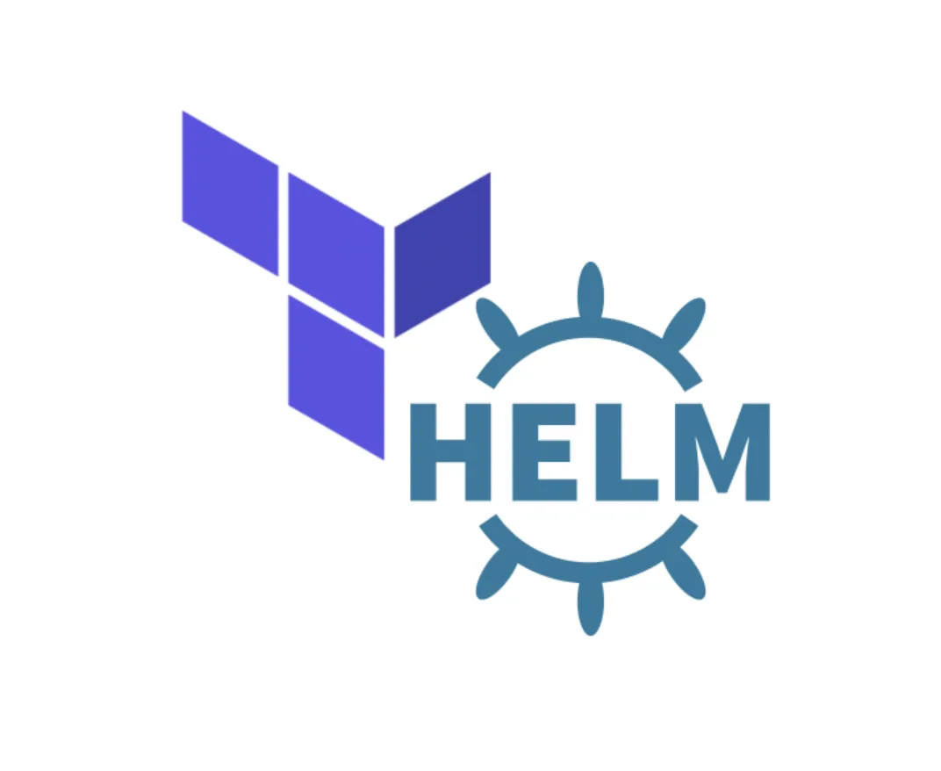
Infrastructure
Helm Chart
Helm is a package Manager for Kubernetes
They provide a standard, opinionated way to install, configure, upgrade, and run an application in a matter of minutes
Terraform
Terraform is a tool for building, changing, and versioning infrastructure safely and efficiently
Terraform can manage existing and popular service providers as well as custom in-house solutions

Slide 10

Infrastructure
Ingress
Kubernetes ingress is a collection of routing rules that govern how external users access services running in a Kubernetes cluster
Implemented Ingress resource configuration for external users service
Prometheus
The Prometheus server is deployed on Kubernetes cluster and analyse and monitor the application traffic on grafana dashboard

Slide 11
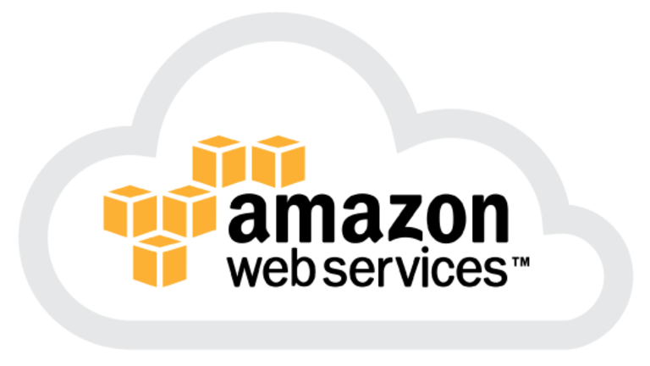

Infrastructure
AWS ELB
All the incoming requests from the client are load balanced on the AWS using the ELB service of the AWS
Grafana
Metrics are displayed using Grafana dashboard
HPA is used for pod autoscaling based on CPU load
Custom metrics using service monitor and Prometheus client

Slide 12


